Slide 1
Parallel Transmit, from fields to excitations to sequences
Prof Shaihan Malik

Slide 2
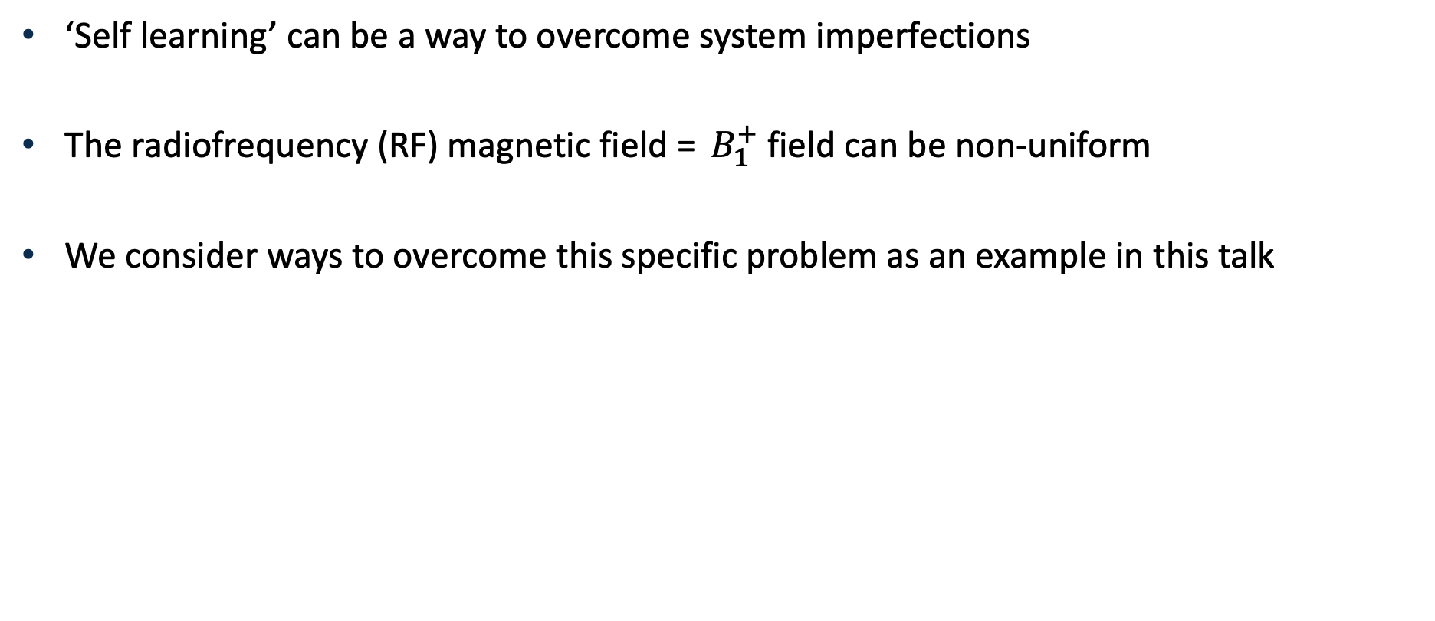
Control of imperfections
‘Self learning’ can be a way to overcome system imperfections
The radiofrequency (RF) magnetic field = $B_{1}^{+}$ field can be non-uniform
We consider ways to overcome this specific problem as an example in this talk

Slide 3
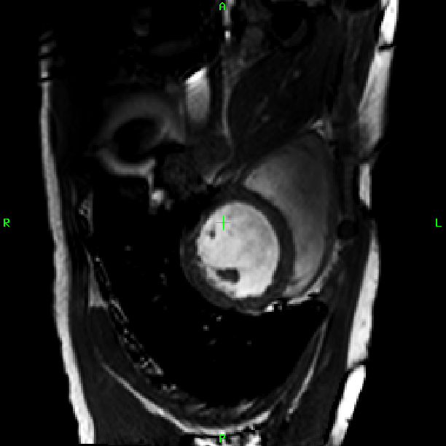
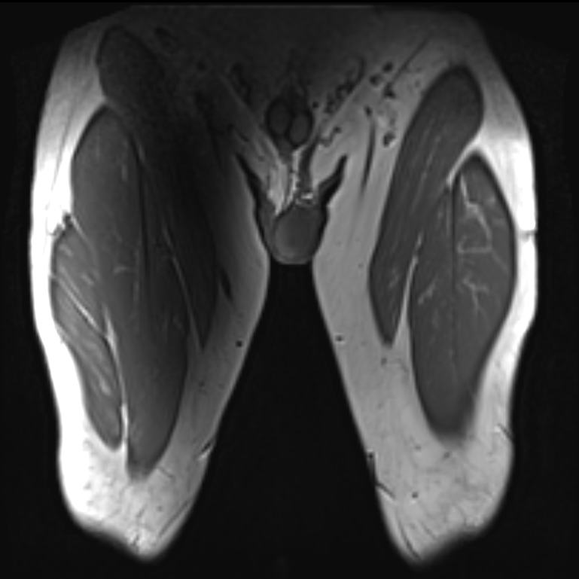
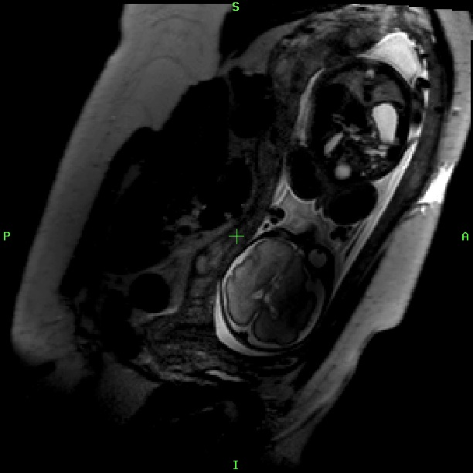
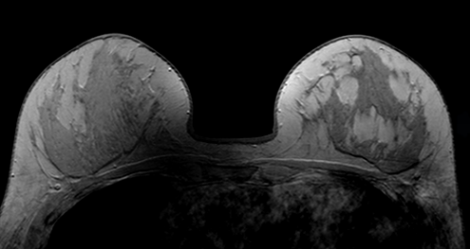
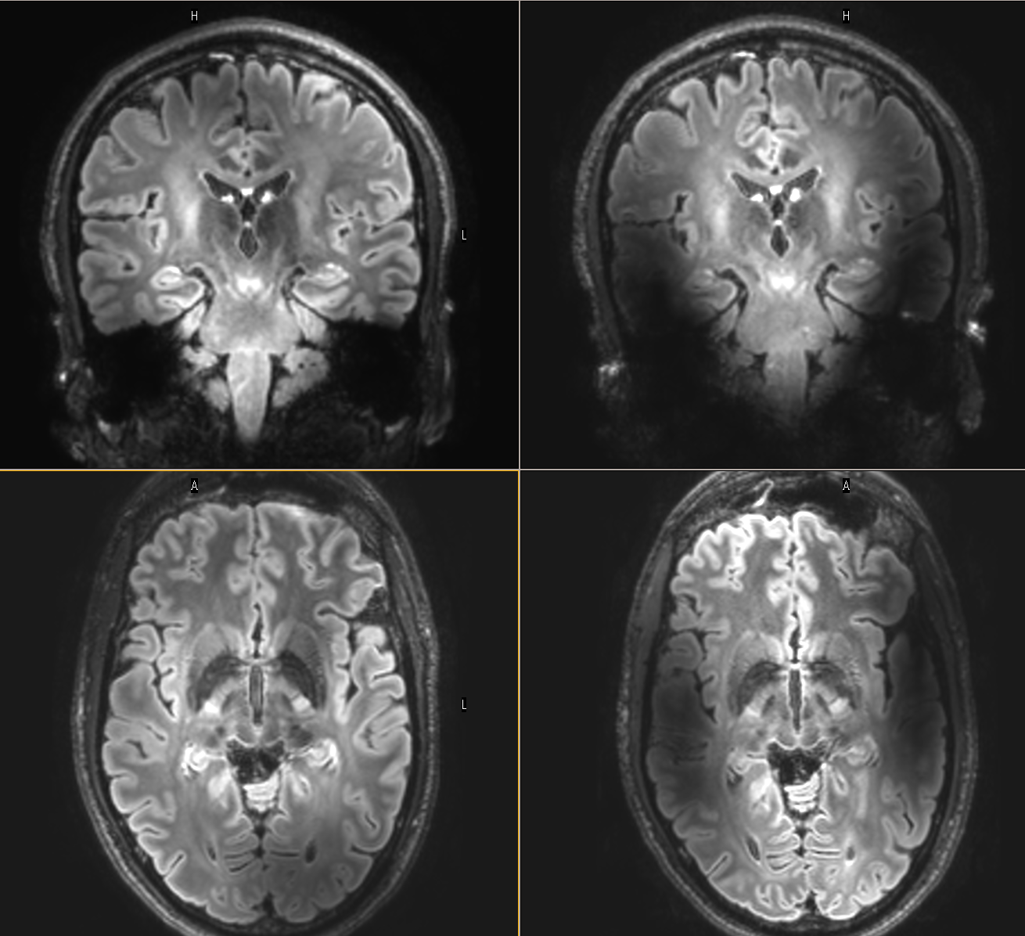
B₁ inhomogeneity
Problematic for clinical 3T imaging
Variability between subjects
Effects get worse as B₀ increases
Cardiac (short axis)
Thighs (coronal view)
Foetus (in utero)
Breast (axial view)
7T Brain image
Notes:
About 10% of whole body scanners (~400 total), but 20-30% of new installs
3Ts now in NHS trusts country wide

Slide 4
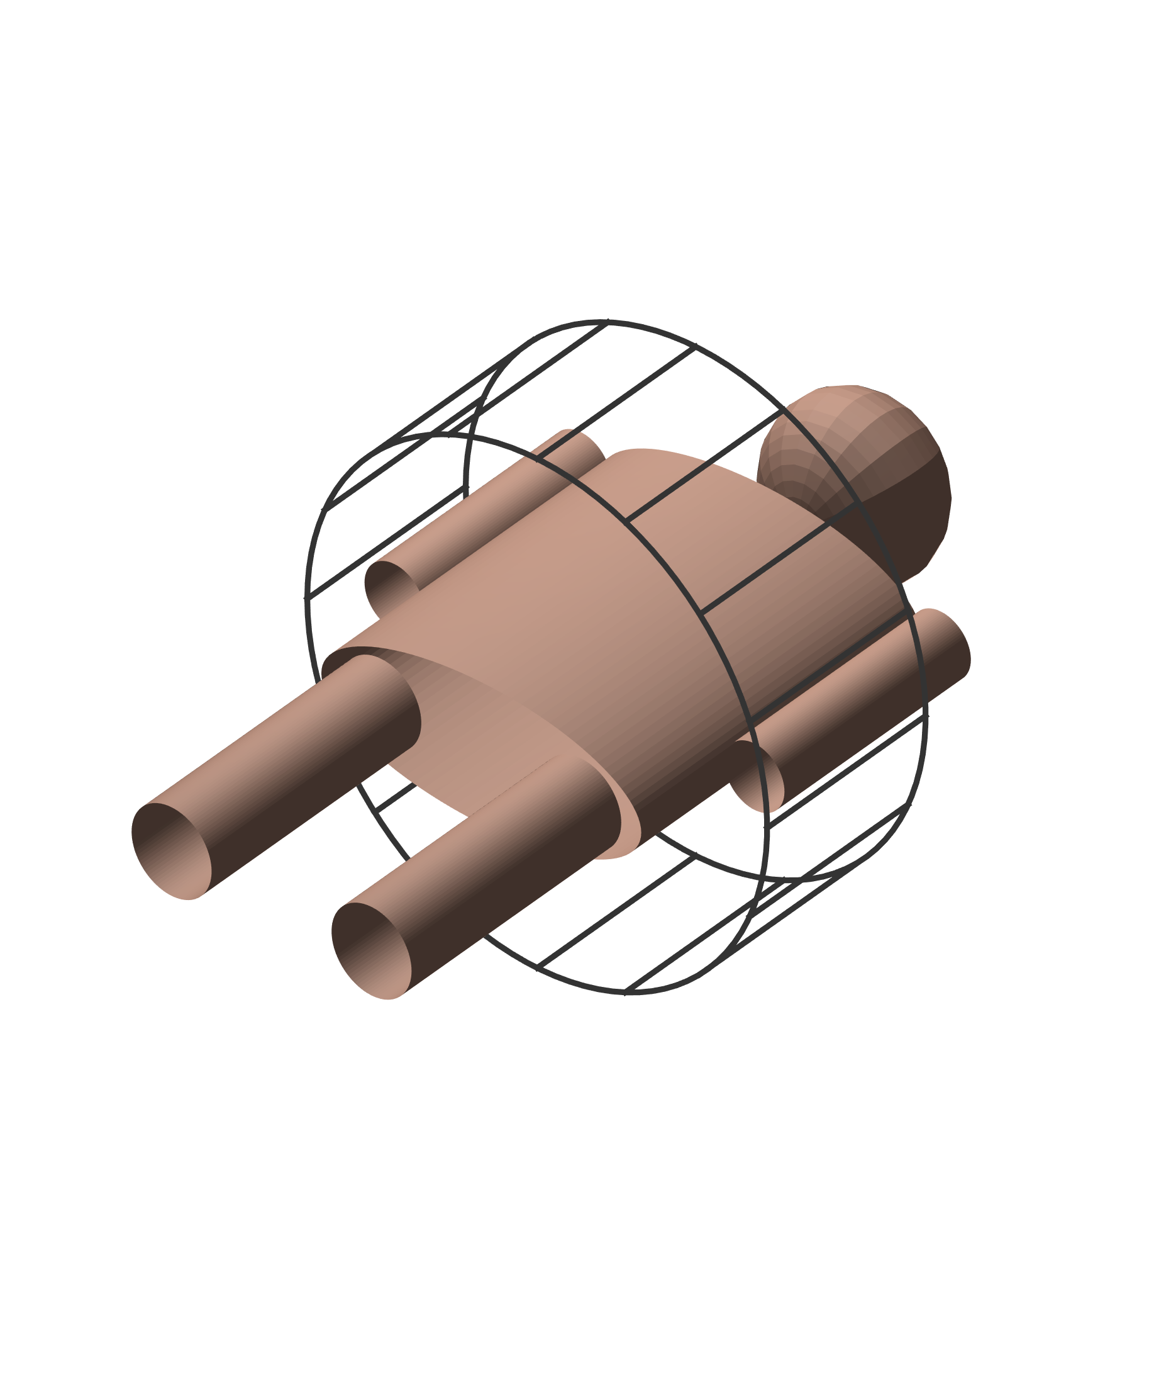
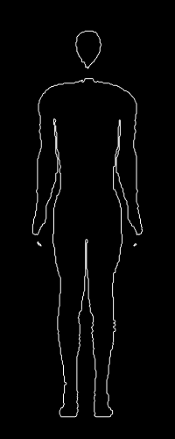
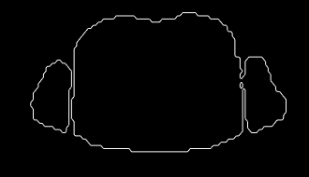
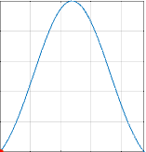
What is parallel transmission?
‘Transmission’ = Generate RF magnetic field (‘B₁’)
B₁ during RF pulse at 3T
0
90
B₁ field not spatially uniform at high field (3T+)
Standard, single channel transmission
b(t)
Spatial properties depend on EM interaction between body and coil – we cannot control this.

Slide 5
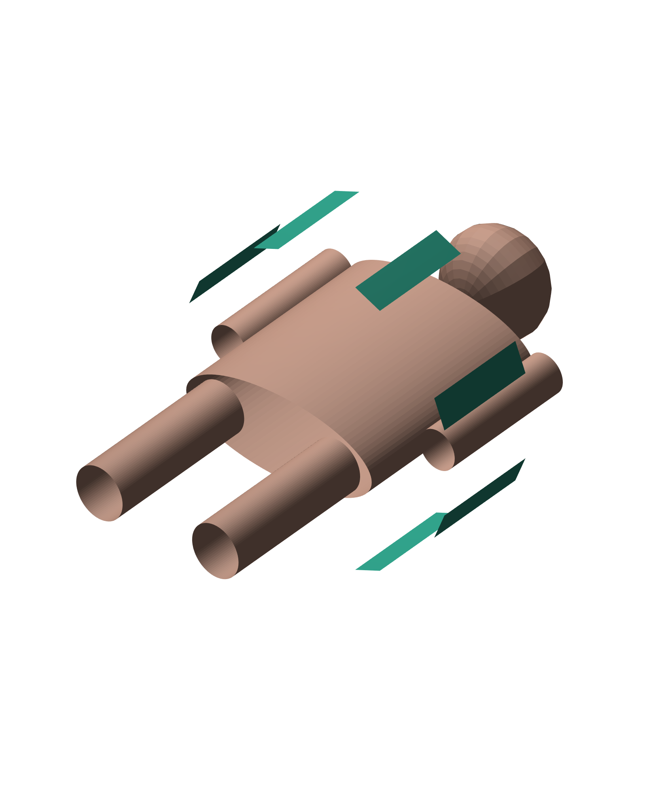
Parallel Transmission
Move from large resonator with single input to an array of smaller coils with their own RF amplifier
Schematic closely resembles an old experimental 3T pTx body array but can be any array coil
0
90

Slide 6
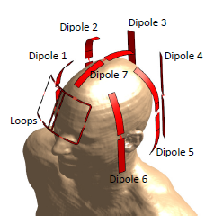
Parallel Transmission
Move from large resonator with single input to an array of smaller coils with their own RF amplifier
Key property: Each coil can be driven with separate RF waveform
Modern commercial 3T systems often use 2-port birdcage coils
Clement et al, MRM 2019;81:1447-1458

Slide 7
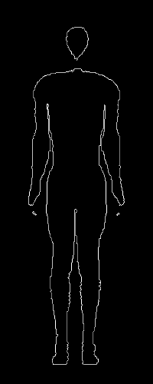
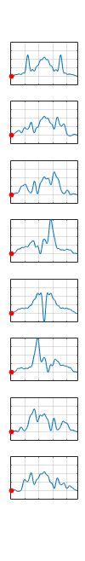
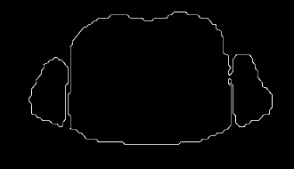
Parallel Transmission: spatial & temporal control
RF magnetic field: B₁
Parallel transmission:
PTx allows spatial and temporal control of the B₁ field
b_{i}(t)
By controlling the inputs on each coil separately we can make B₁ vary in space and time. But how to use these degrees of freedom?

Slide 8
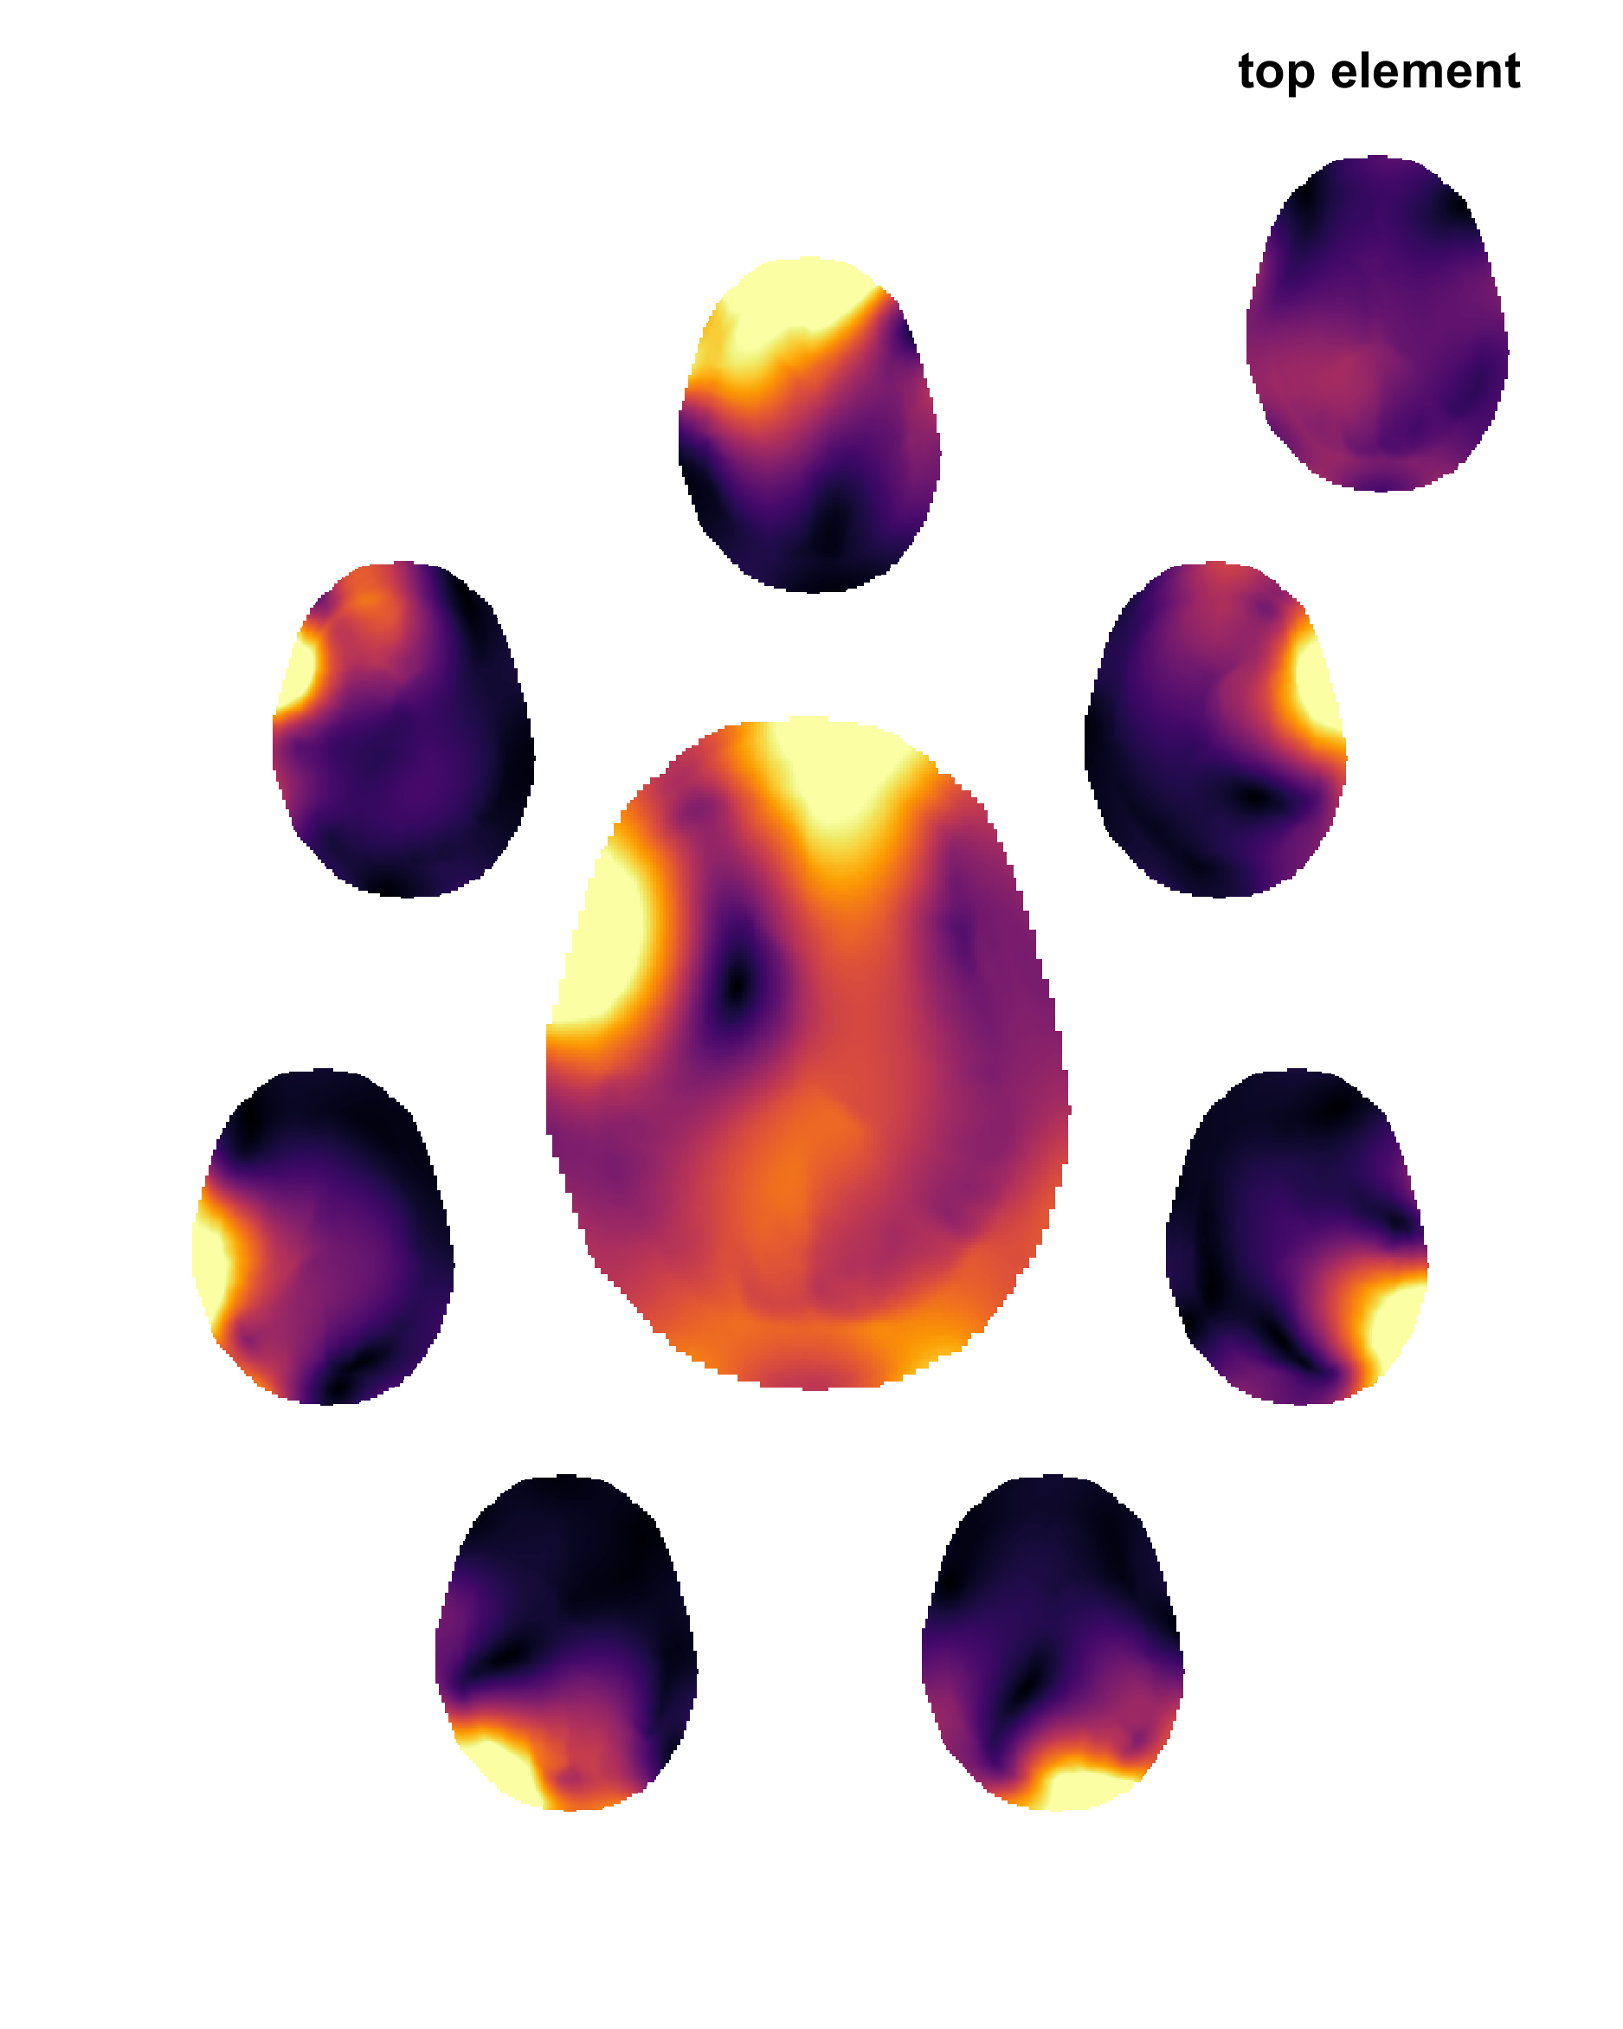
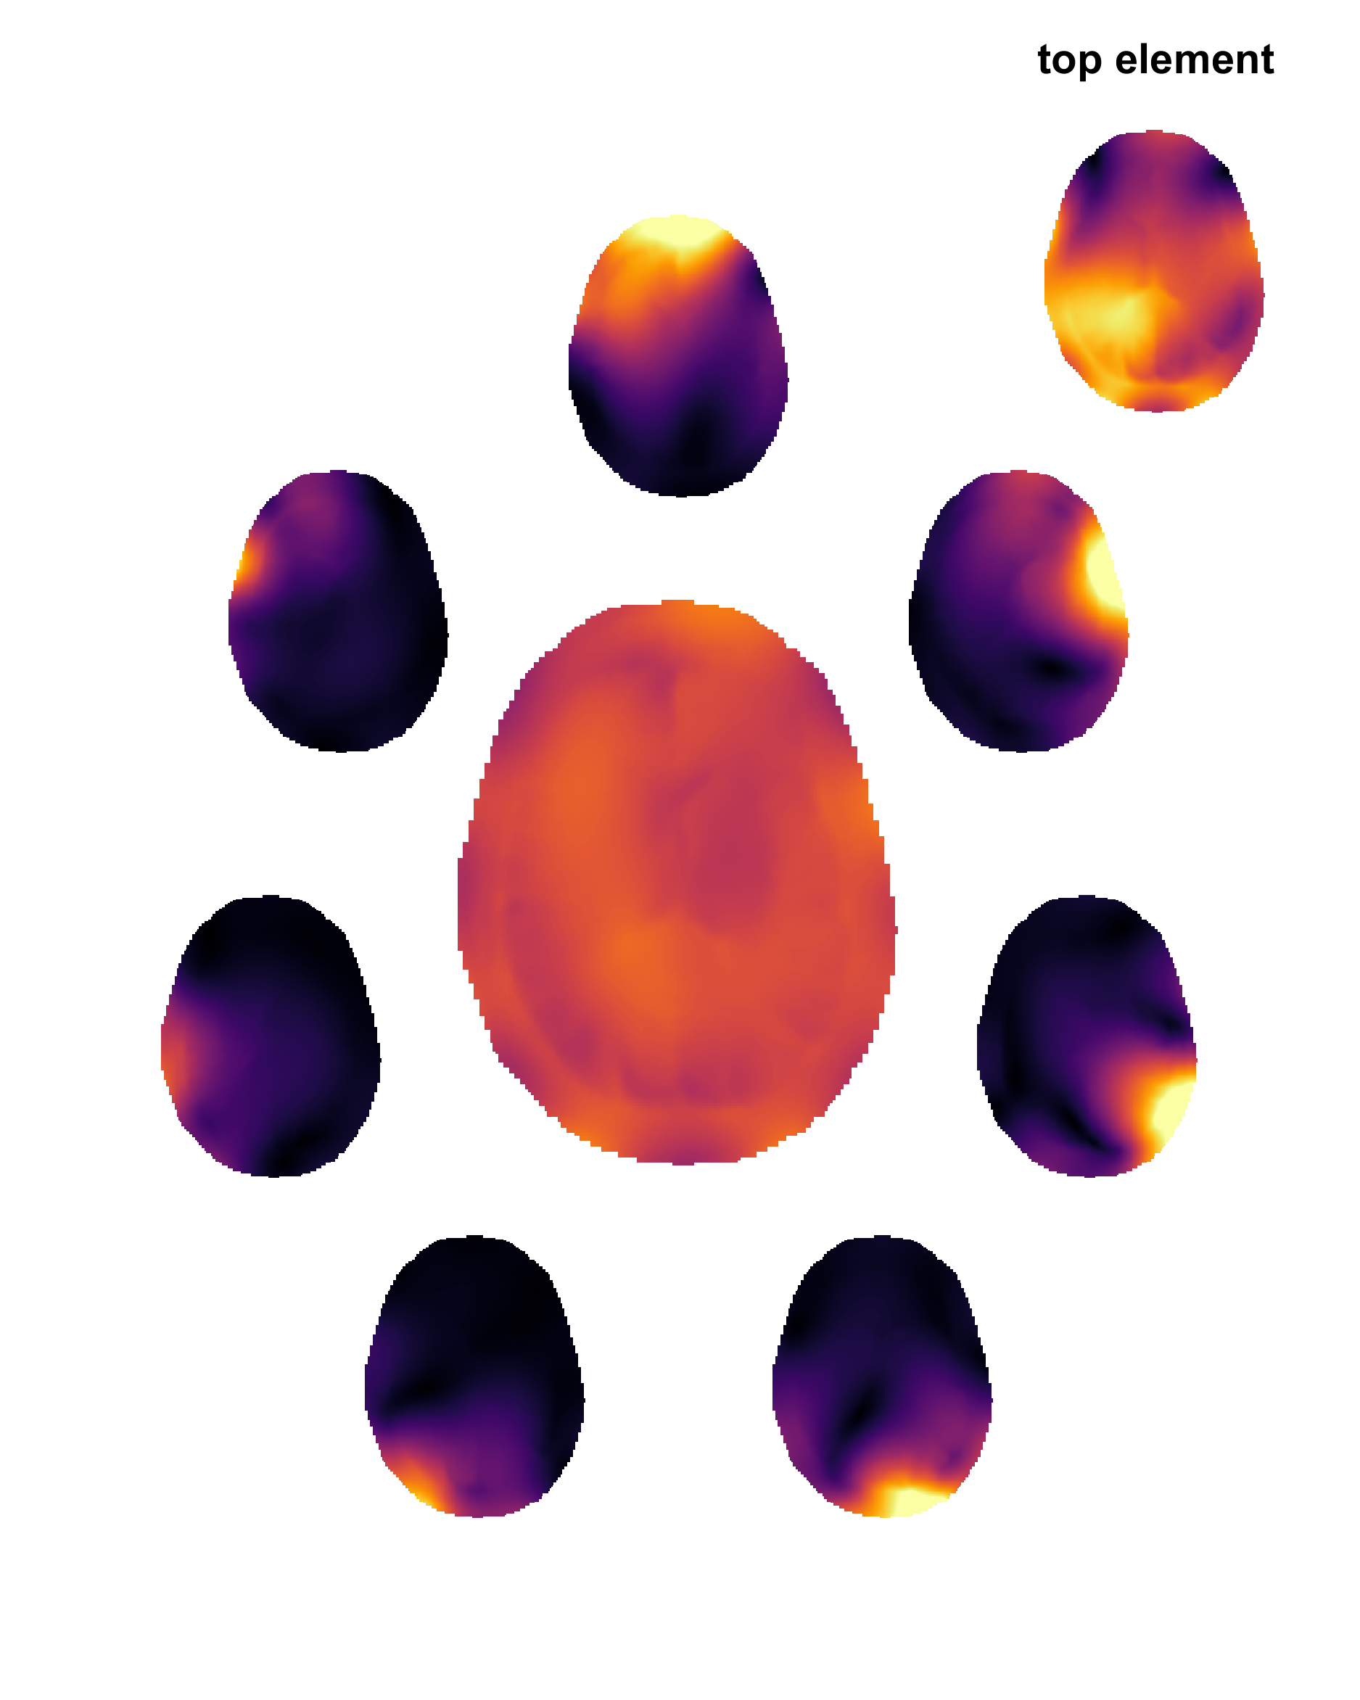
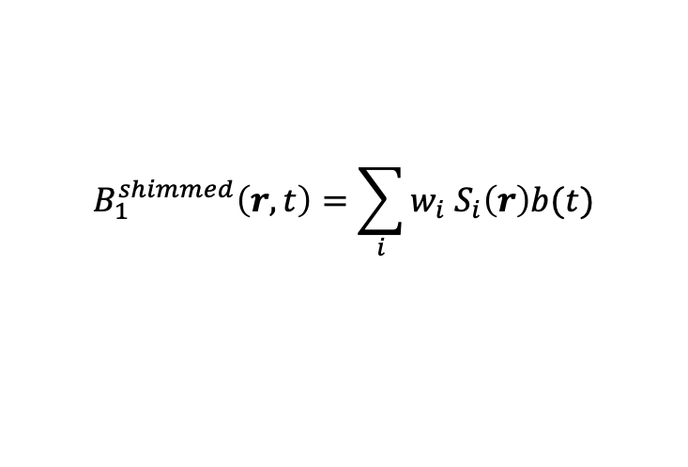
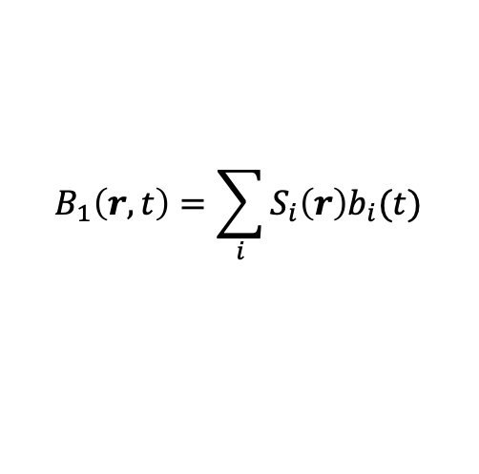
RF shimming (aka ‘static’ pTx)
RF shimming is the simplest and most common application of PTx
find time independent weights
Independent of pulse sequence
Performance depends on field patterns produced by individual coils:
Number of coils
Coil design
$$B_{1}\left(r,t\right)=\sum_{i}{S_{i}\left(r\right)b_{i}(t)}$$
$$B_{1}^{shimmed}\left(r,t\right)=\sum_{i}{{w_{i} S}_{i}\left(r\right)b(t)}$$

Slide 9
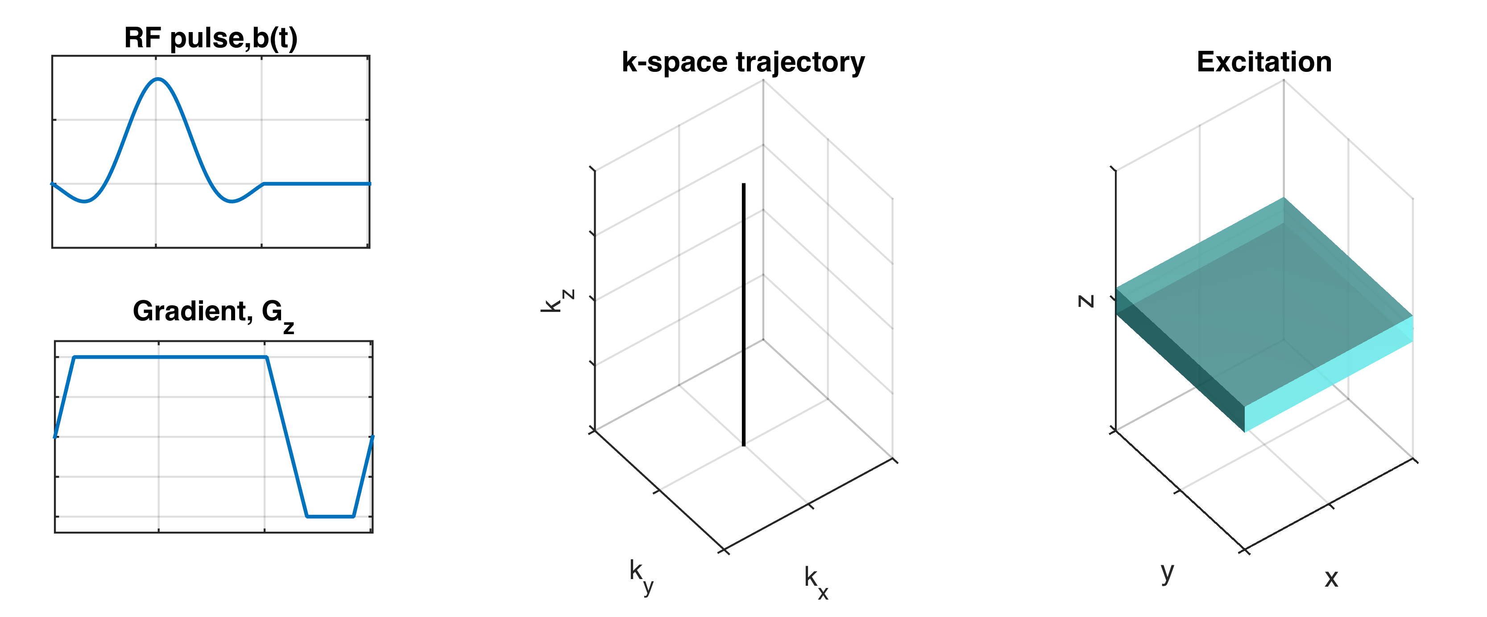

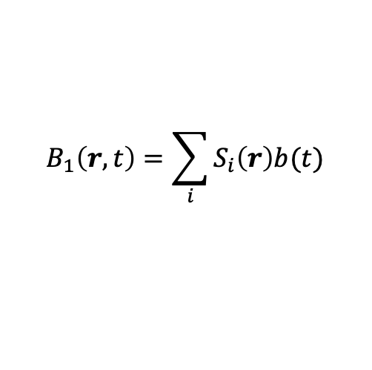

From Fields to Excitations (‘dynamic’ pTx)
B₁ field is used to excite magnetization
Integrate the Bloch equation through time to predict ‘excitation’ properties
‘Small tip angle’¹ => Fourier approximation …
$$B_{1}\left(r,t\right)=\sum_{i}{S_{i}\left(r\right)b(t)}$$
Contains $B_{1}^{+}$ and $B_{0}$ including gradients
$$\dot{M}=γM×B$$
m
=
S
F
b
¹Pauly et al, JMR 1989 81(1):43

Slide 10
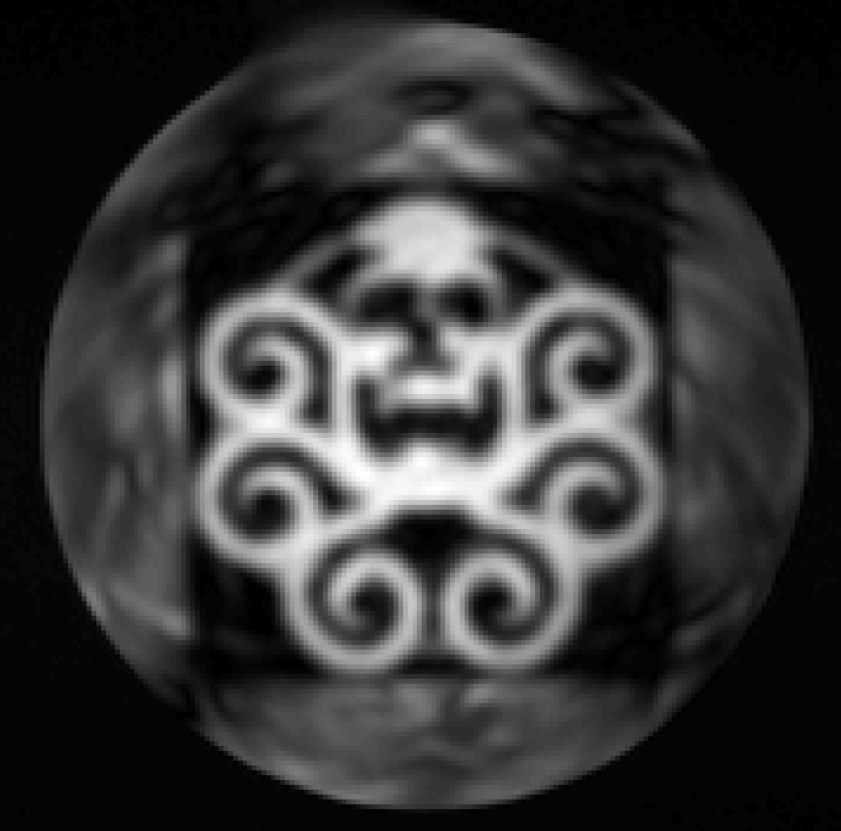
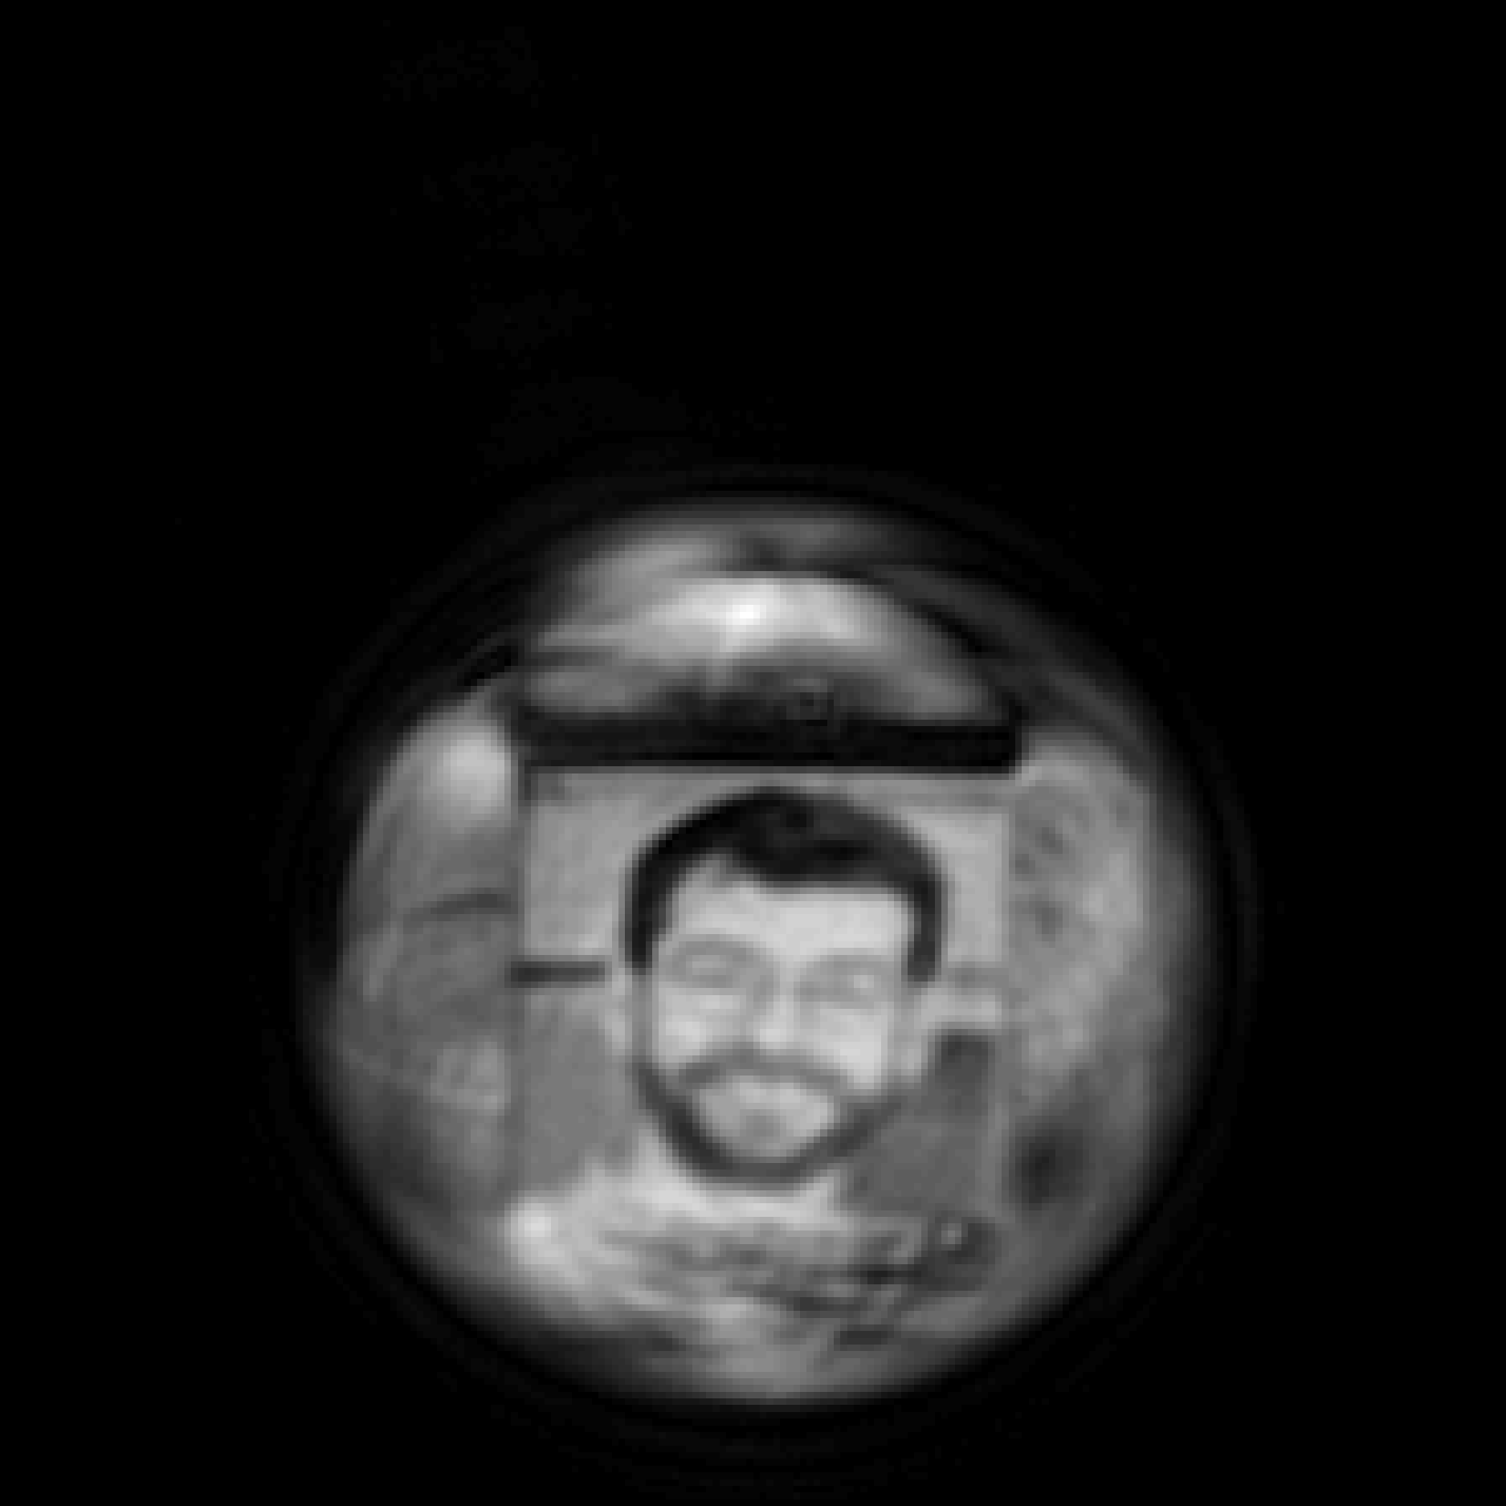
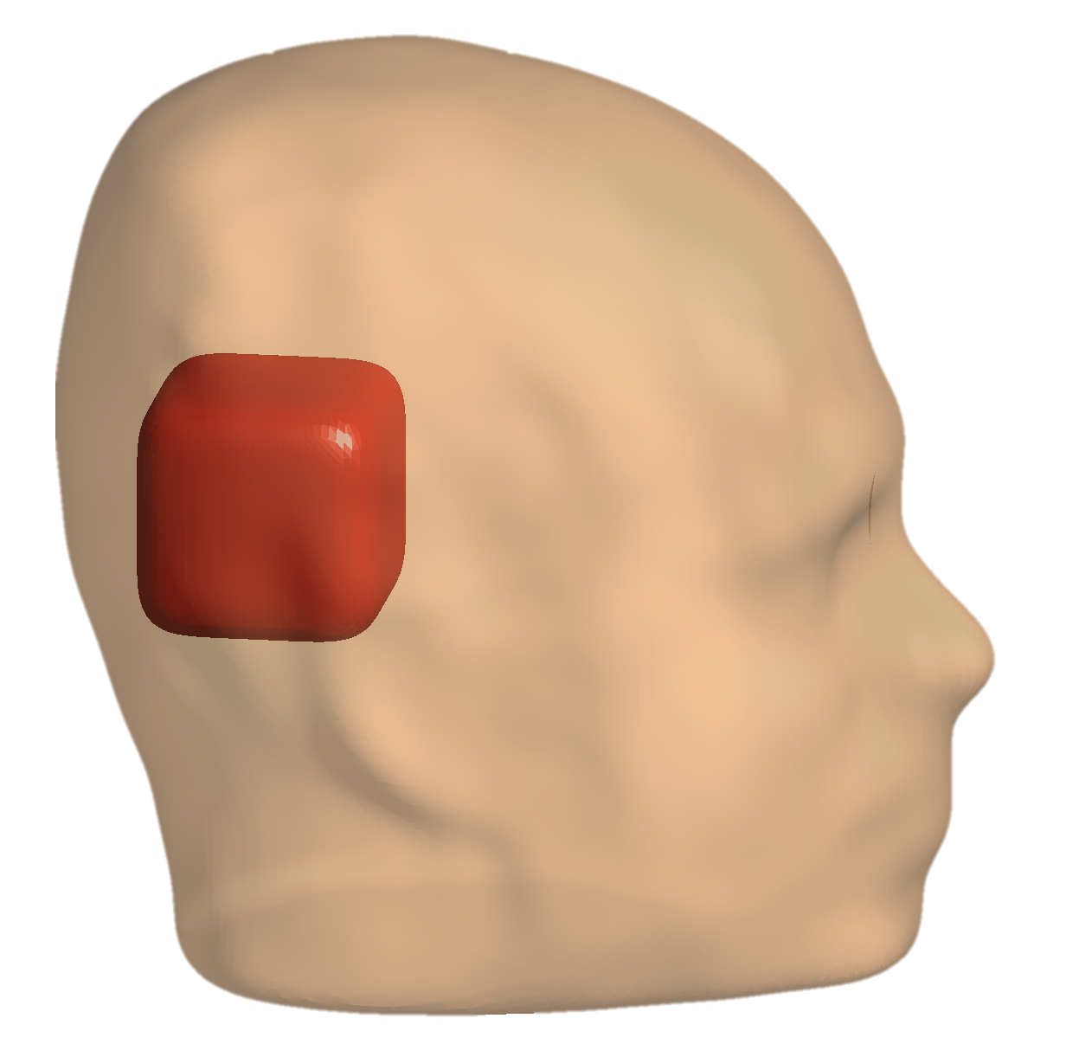
From Fields to Excitations (‘dynamic’ pTx)
With pTx generalise this to multiple channels
Can apply to multidimensional RF pulses where the selection gradient is on multiple axes…
Grissom et al 2006
m = S₁F … S_{R}F
b₁
m = Ab
…
b_{R}
2
2
Ab - m
+ λ b
min
b
W
¹Malik & Hajnal, MRM 2016 76(3):848
‘artistic’ images of water phantoms are a common demonstration…
Notes:
PULSED B1 field
My papers – pioneering translational work

Slide 11
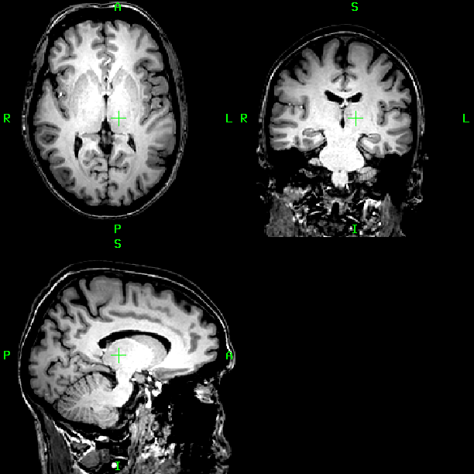
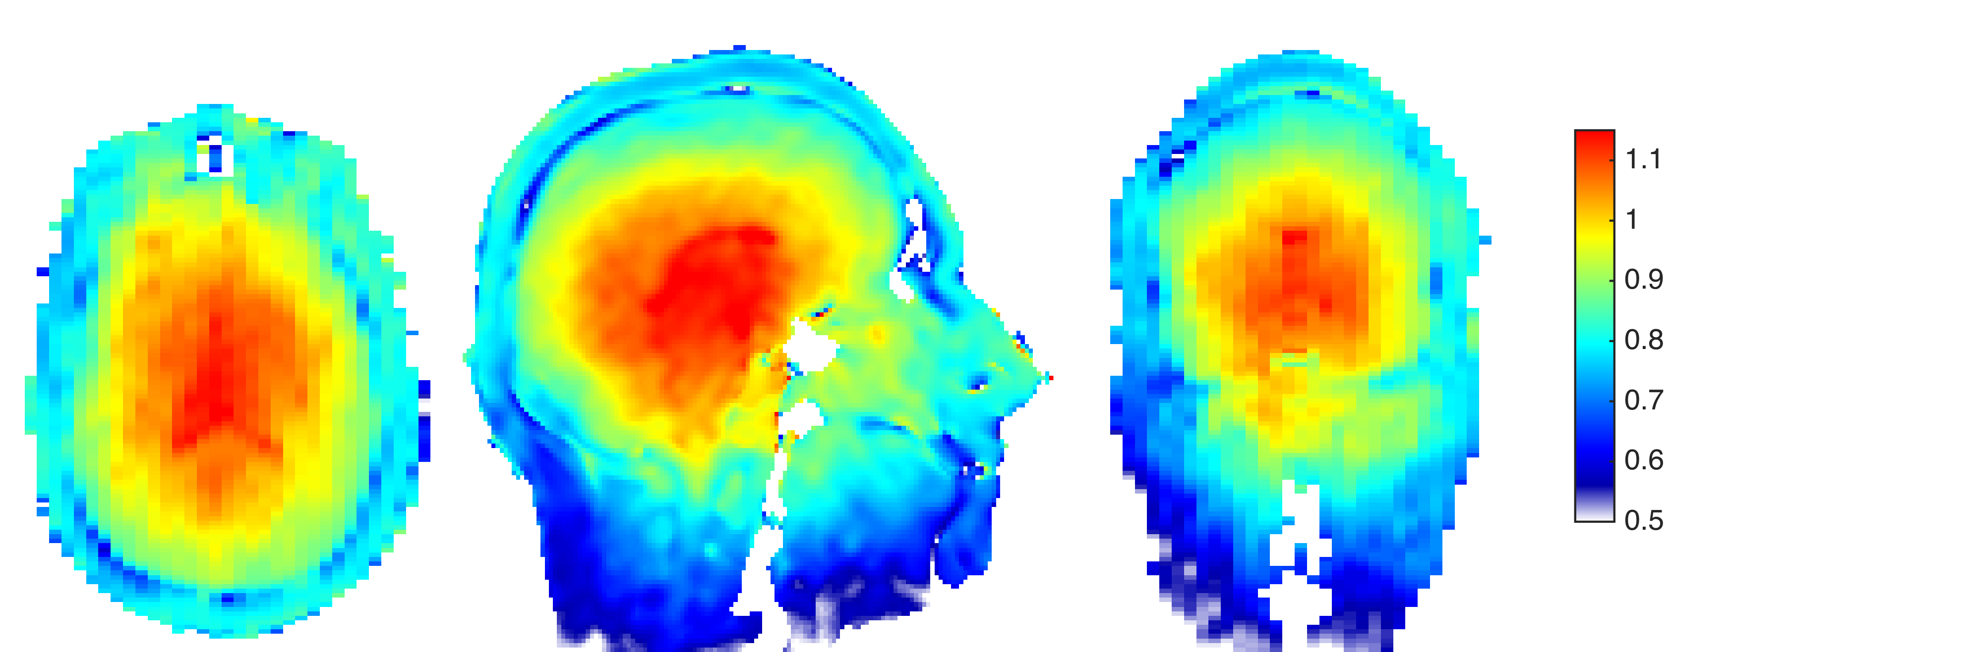
B₁ Homogeneity correction
Can use same machinery to produce spatially uniform excitations from non-uniform fields
Example: T₁w volumetric imaging at 3T with MP-RAGE …
Typical B₁ variation at 3T
‘centre brightening’ artefact

Slide 12
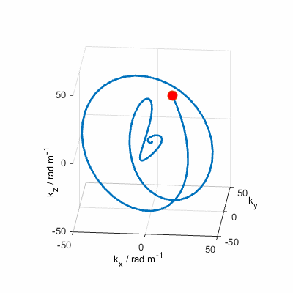
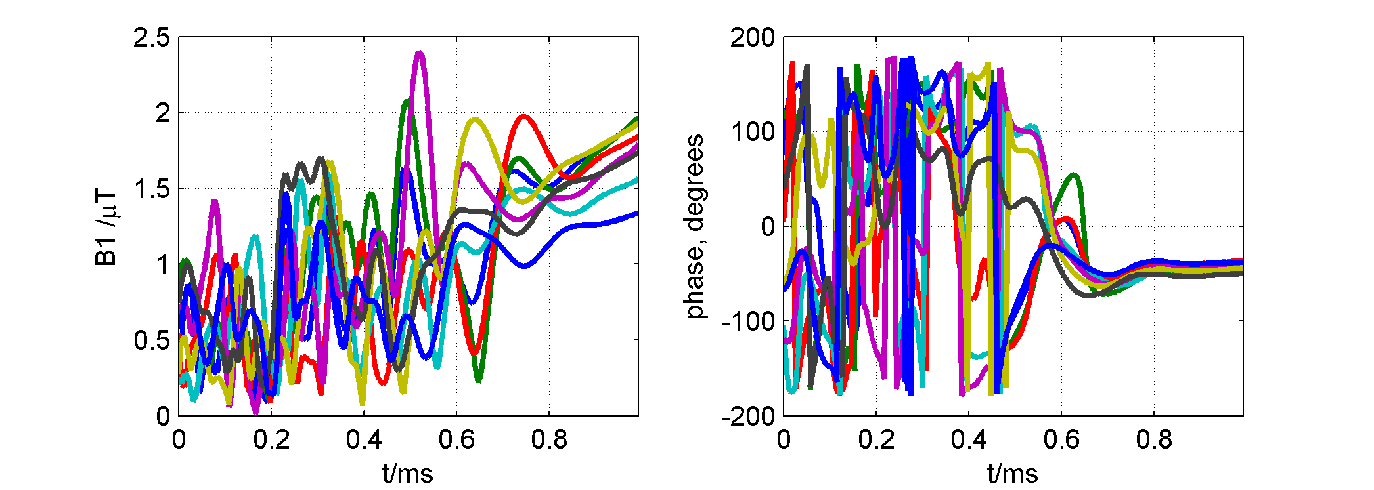
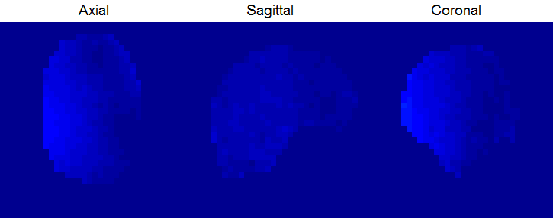
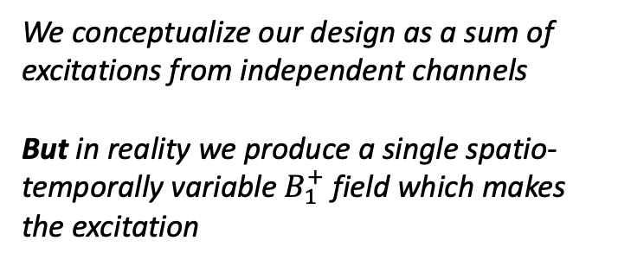
SPINS Pulse waveforms
RF pulse waveforms
B₁ field during transmission
(each colour is a different transmit channel)
We conceptualize our design as a sum of excitations from independent channels
But in reality we produce a single spatio-temporally variable $B_{1}^{+}$ field which makes the excitation

Slide 13
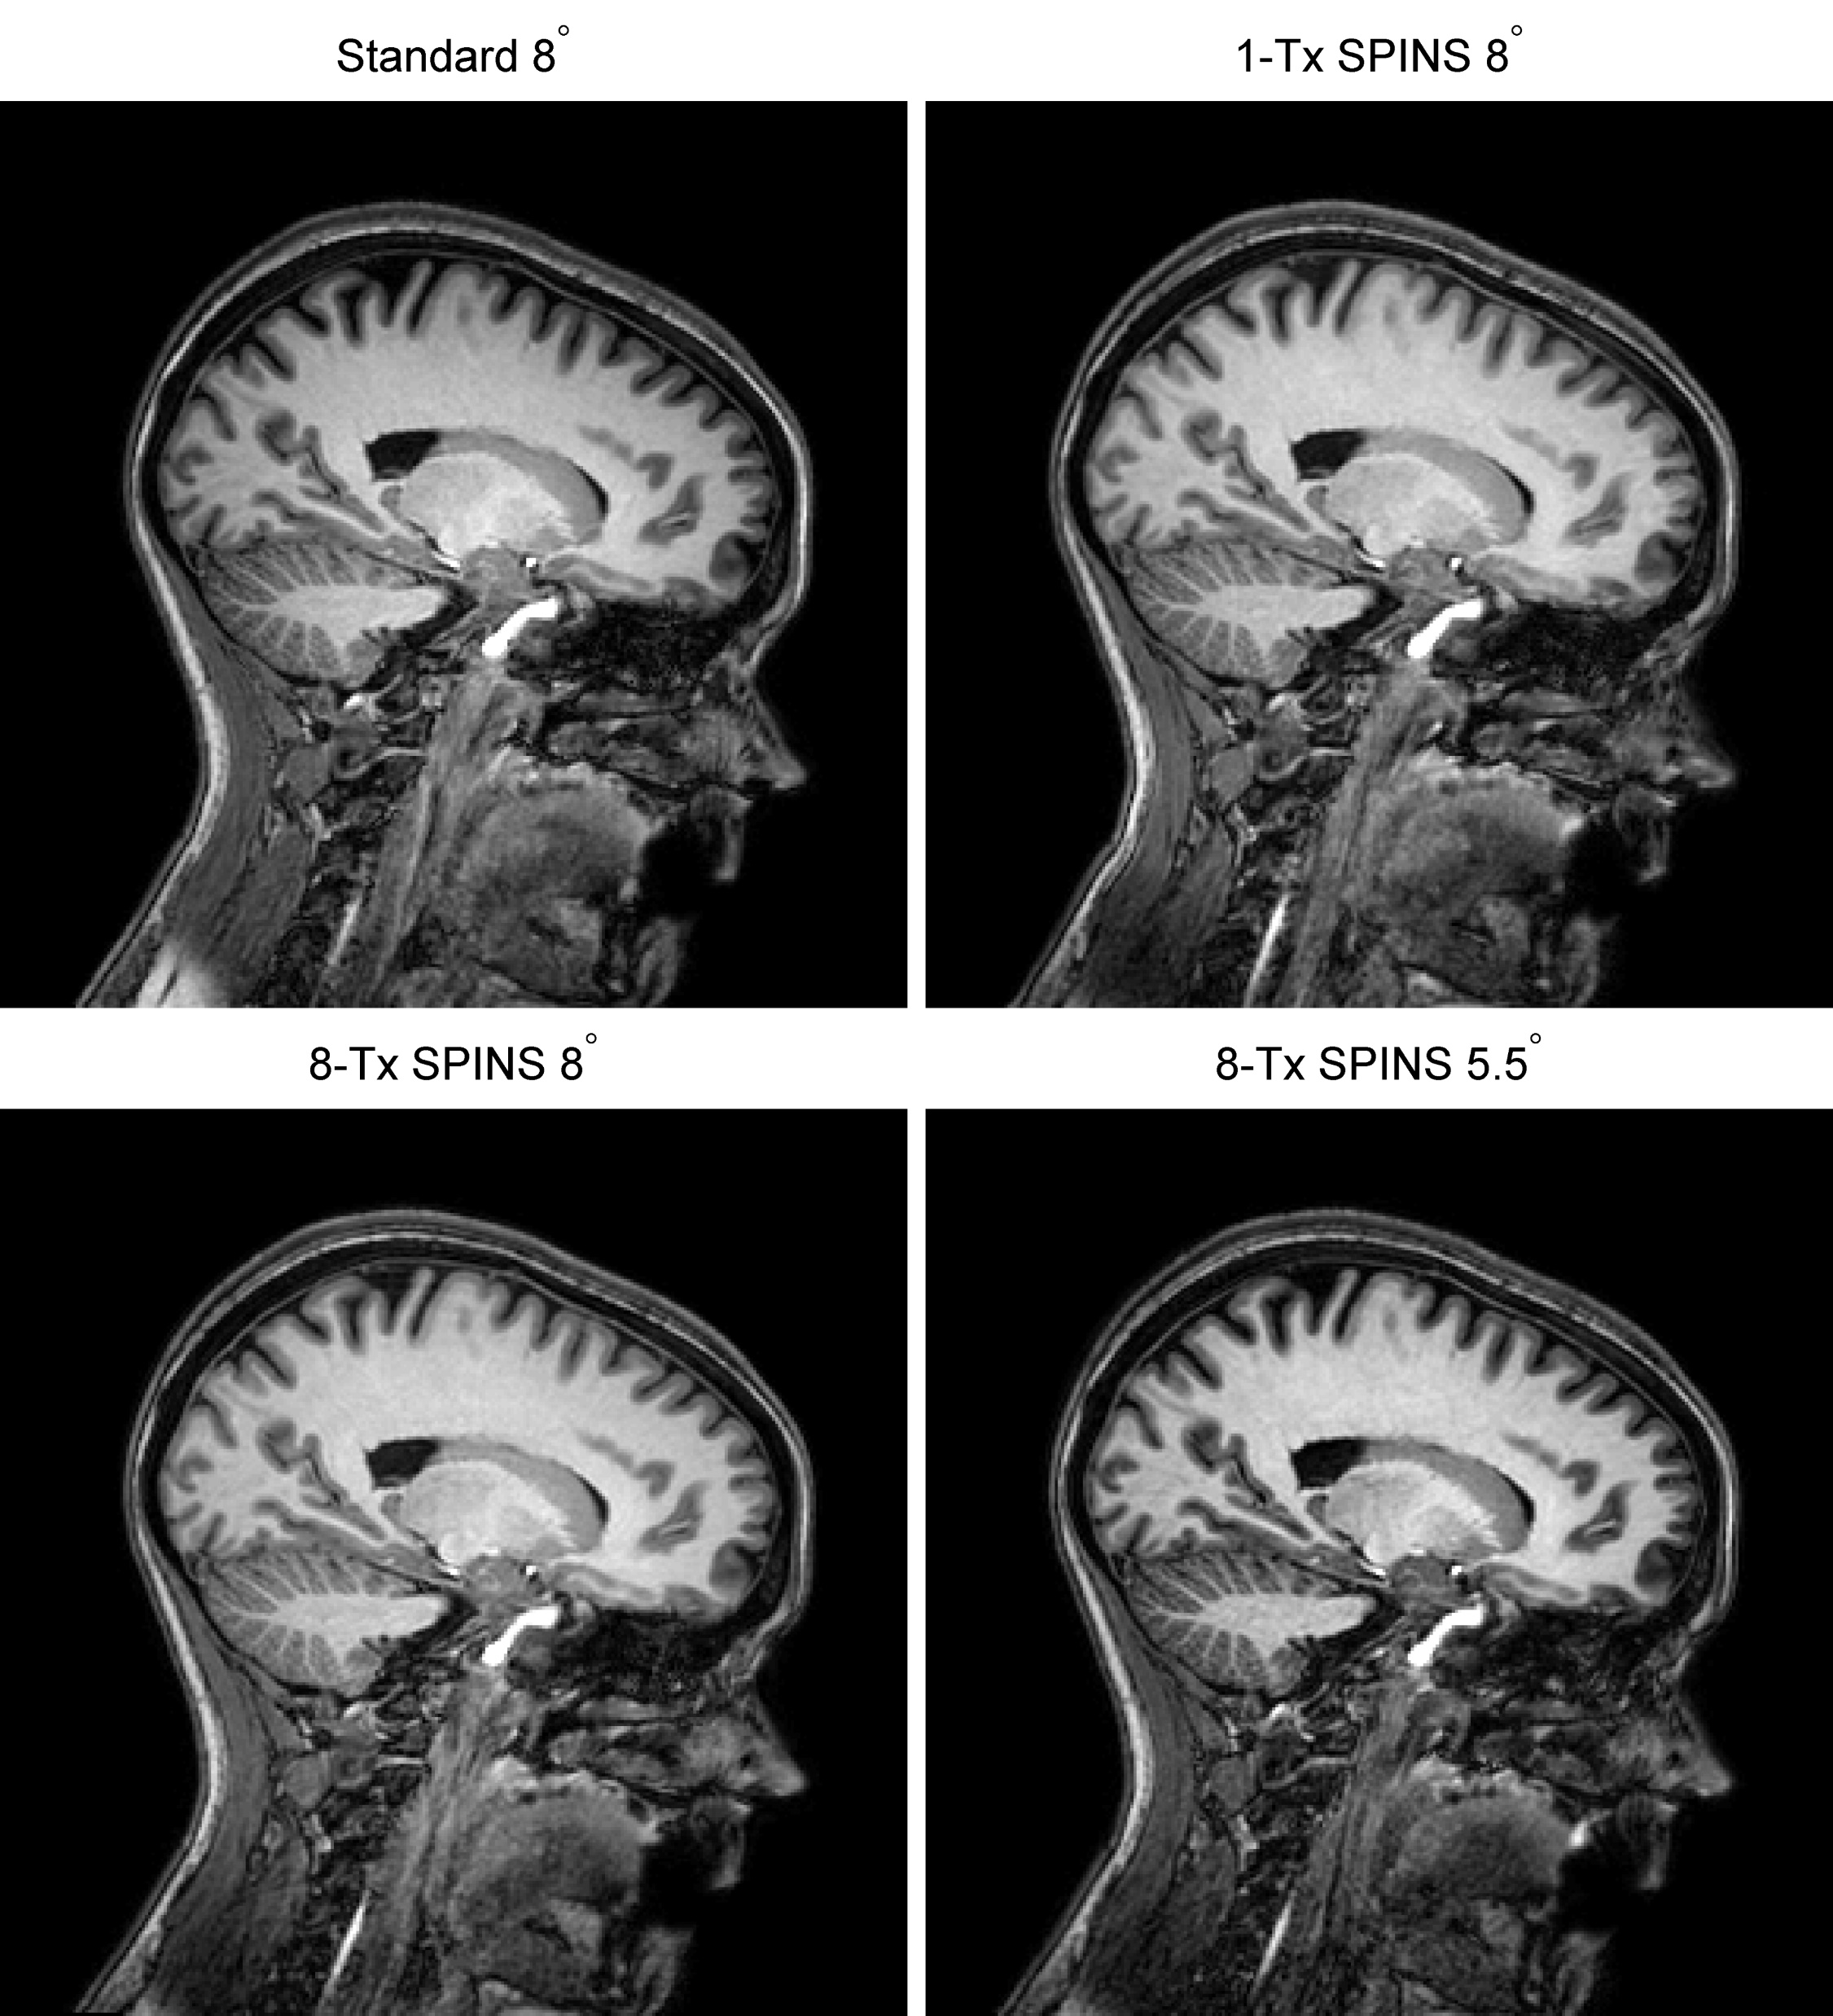
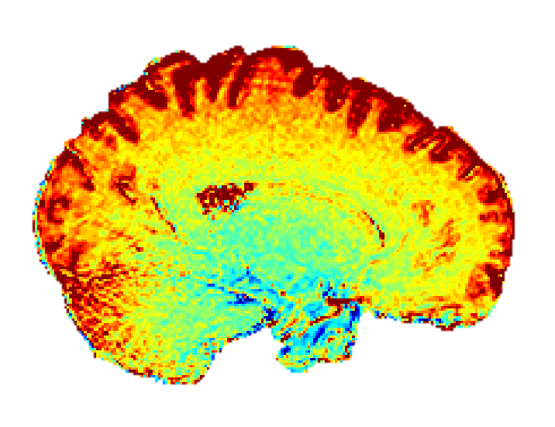
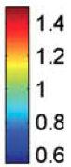
SPINS Results (3T)
+40%
+20%
0%
-20%
-40%
Signal change
Images used the the ADNI MP-RAGE sequence

Slide 14
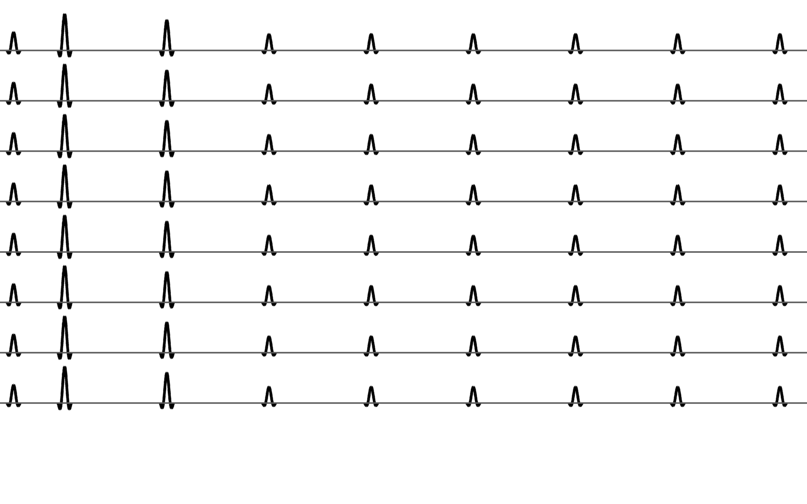
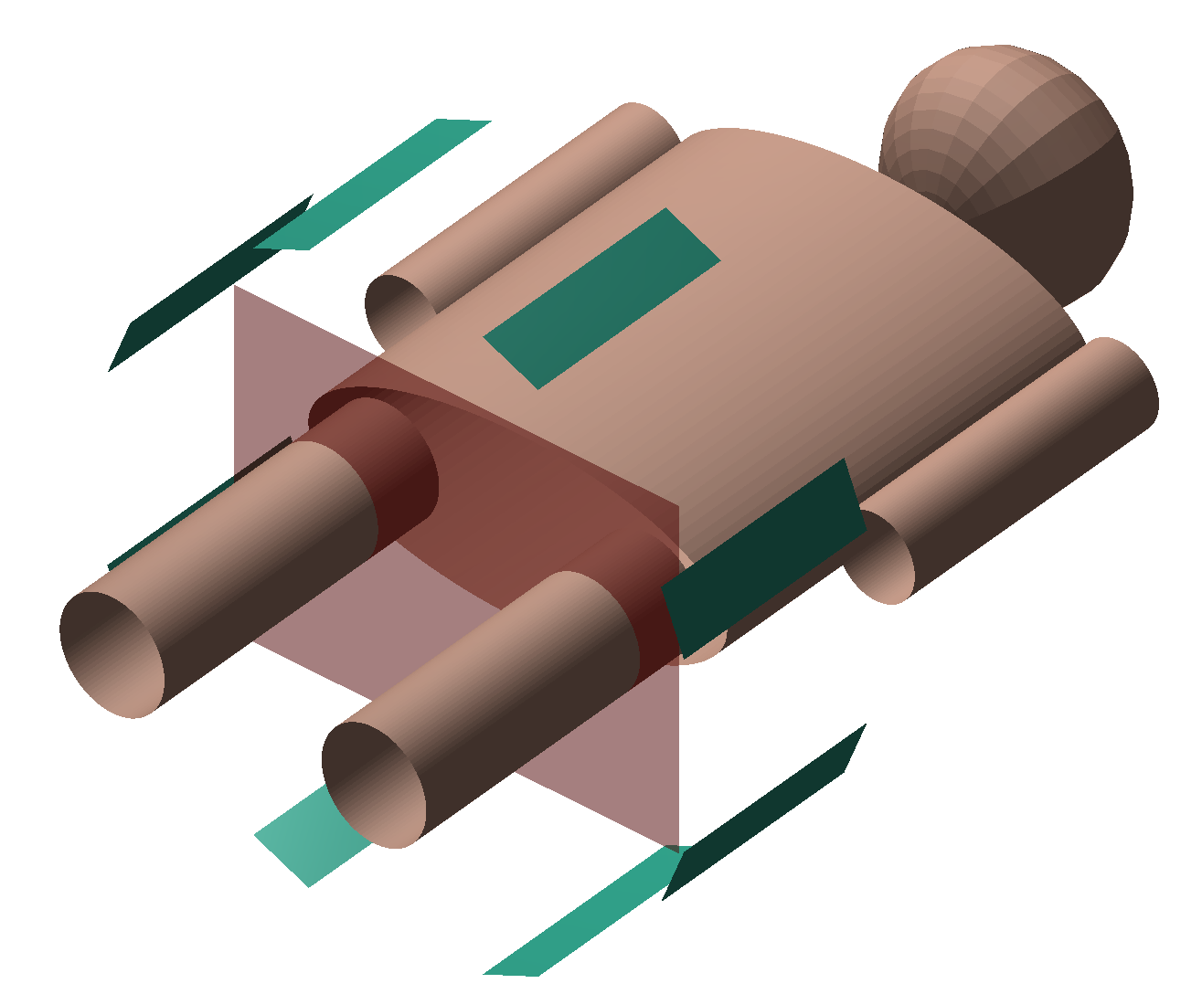
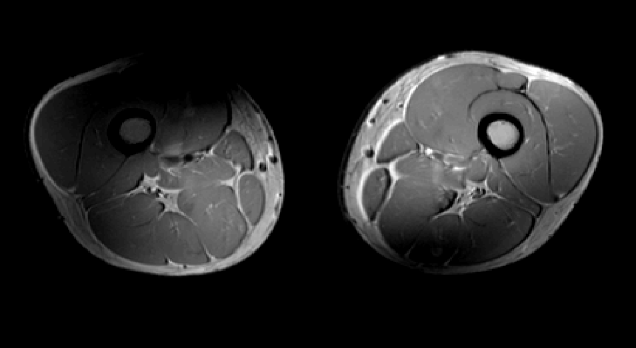
Whole sequence design: Direct Signal Control
Parallel TX channels
μs - ms
milliseconds to seconds
Conventional Pulse Sequence
Signal depends on interactions between pulses and spin system potentially over timescale of entire scan

Slide 15
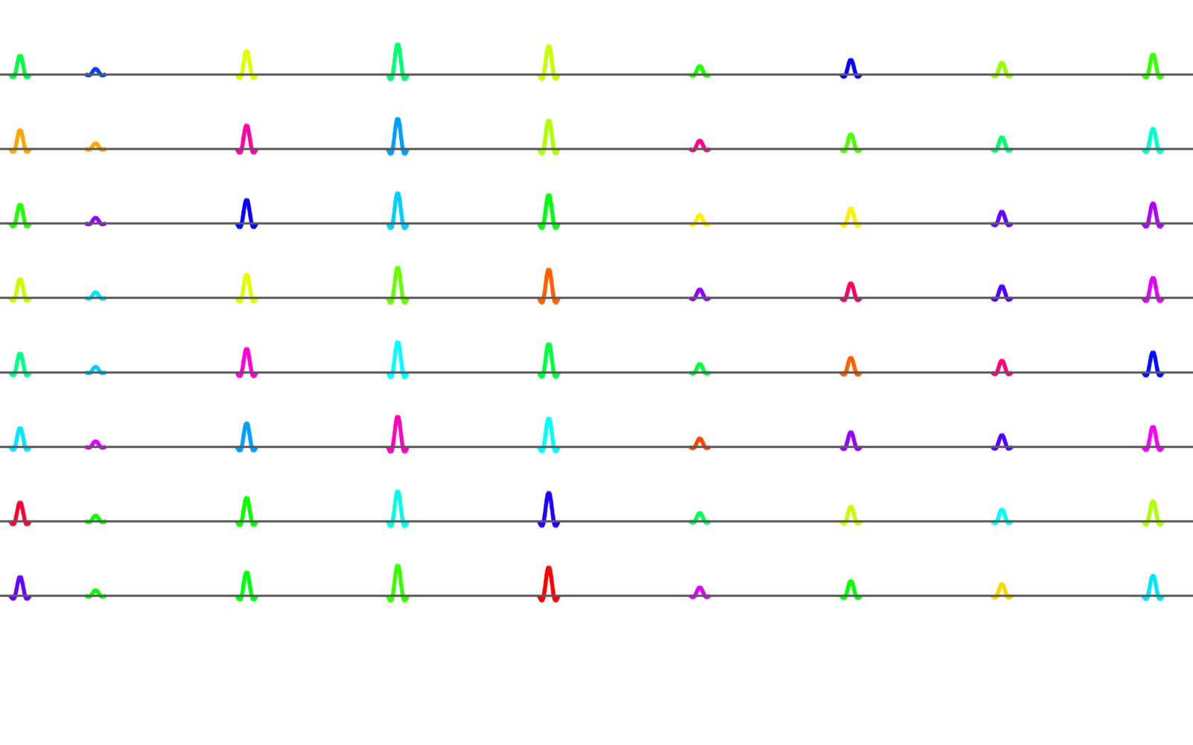
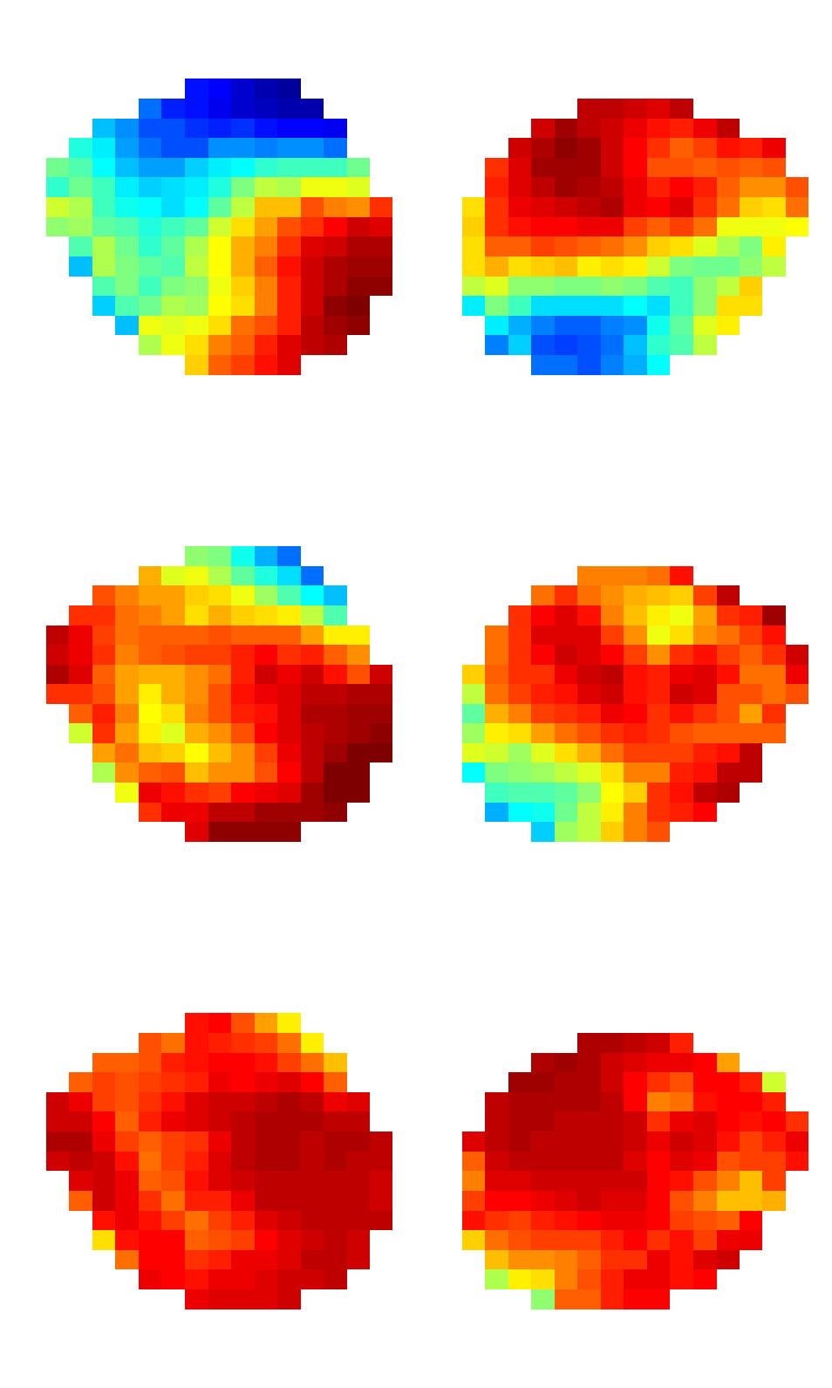
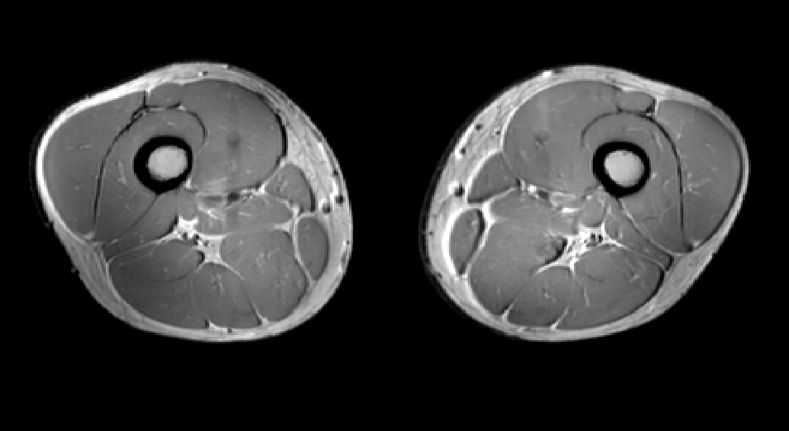
Whole sequence design: Direct Signal Control
Parallel TX channels
Subject-Specific
Signal Model
(measured B₁ maps & sequence properties)
Numerical Optimization
Dynamically control RF on intermediate timescale to control signal evolution
Malik et al, MRM 2012 68(5):1481

Slide 16
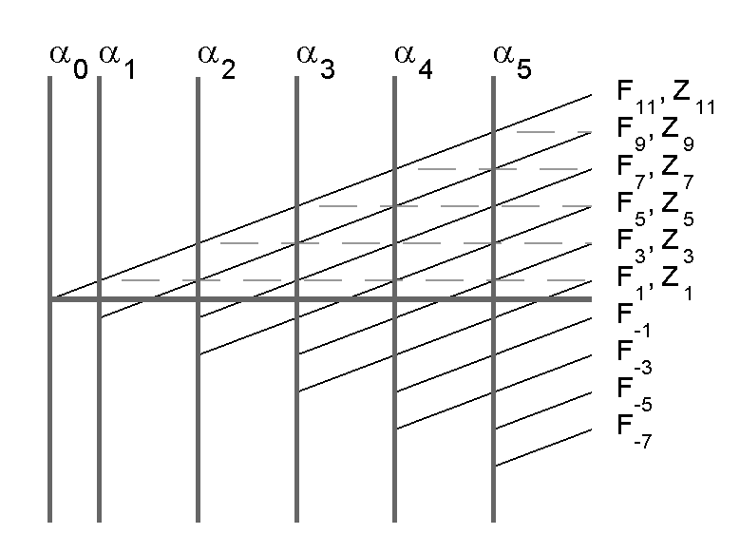
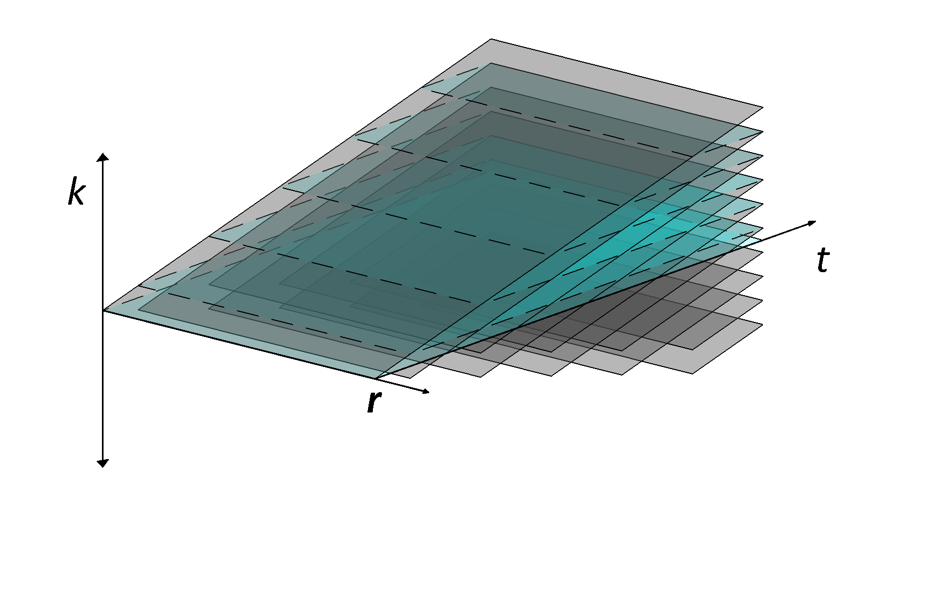
From excitation to signal model
Spatially resolved EPG
Classical non-linear optimization
A is a matrix of all flip angles across all channels, therefore contains all possible FSE variants¹⁻⁴
Find local solutions => start point important
f({α₀,α₁,α₂,… α_{n}},T₁,T₂)
f({α₀(r),α₁(r),α₂(r),… α_{n}(r)},T₁(r),T₂(r))
∑
2
2
min
|S(r)| - T(r)
+ λ A
A
W(r)
r∊Ω
SR-EPG prediction
S(r) = f(A)
Regularization for total RF power
Target signal (for each echo & voxel)
Weighting term

Slide 17
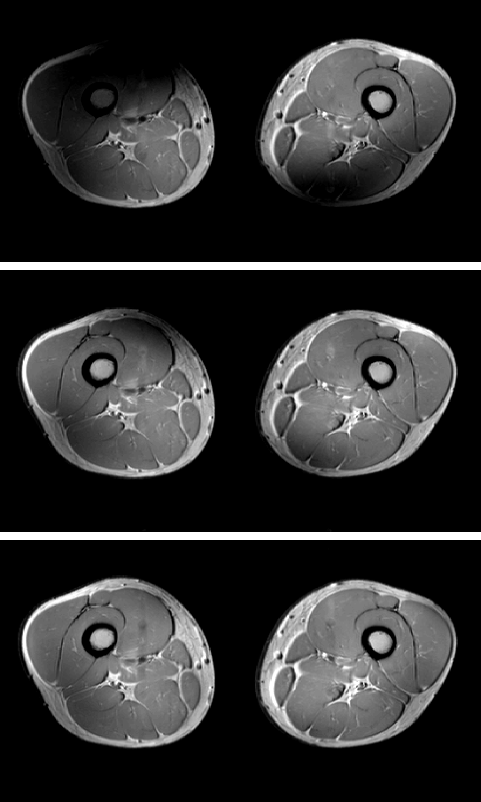
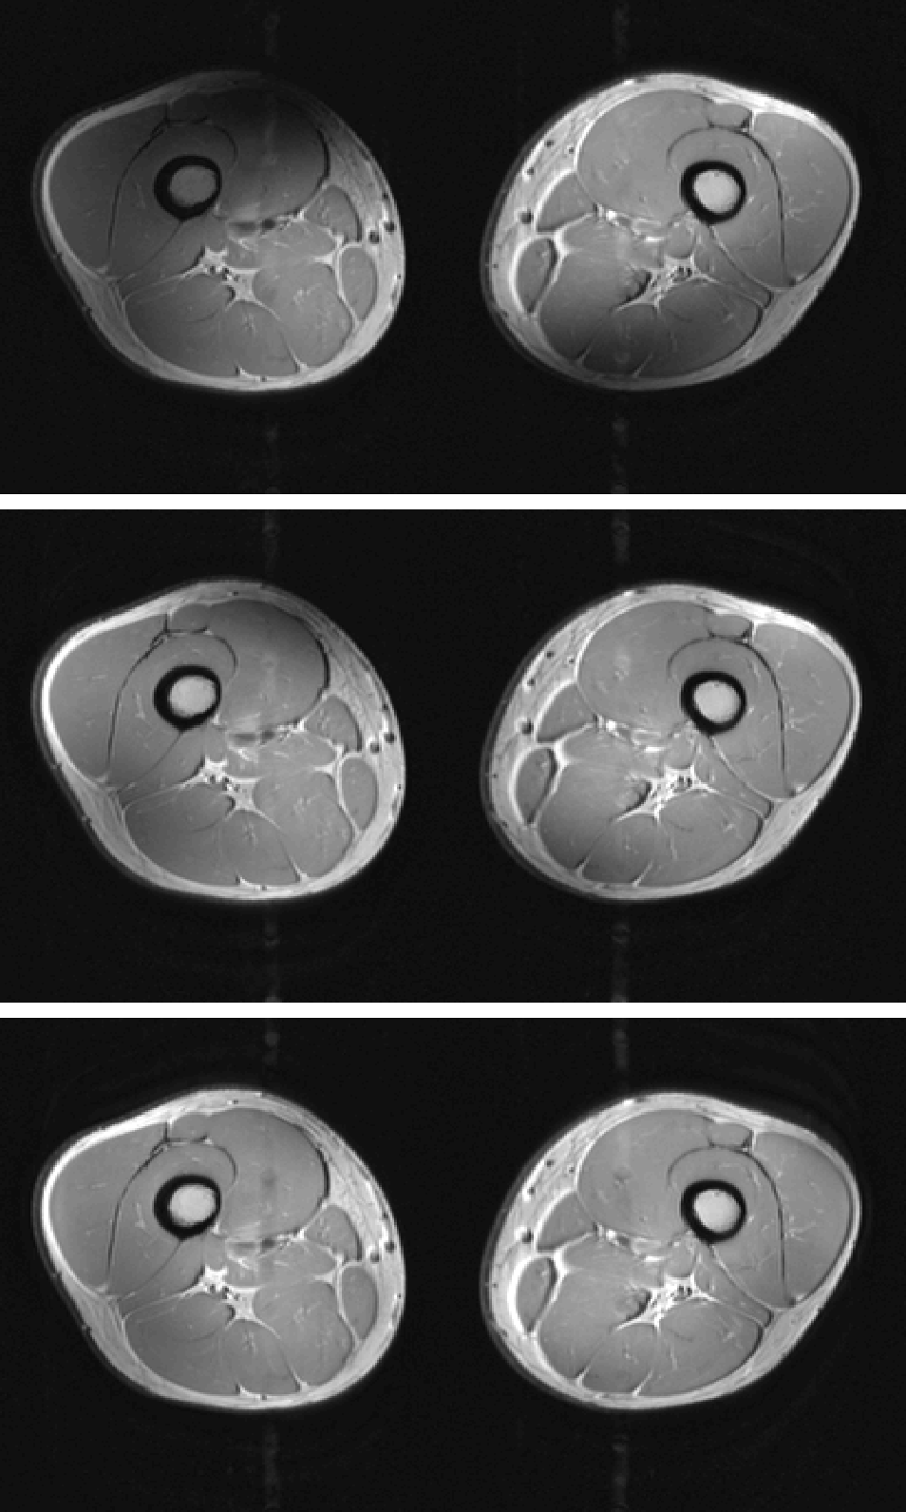
Direct Signal Control: example
Predicted Signals (Spatially Resolved-EPG)
CP mode
‘uniform field’
RF Shim
Direct Signal Control
Images windowed identically
Multi-shot FSE example
“A bit like MR Fingerprinting in reverse”
Malik et al, MRM 2012 68(5):1481

Slide 18
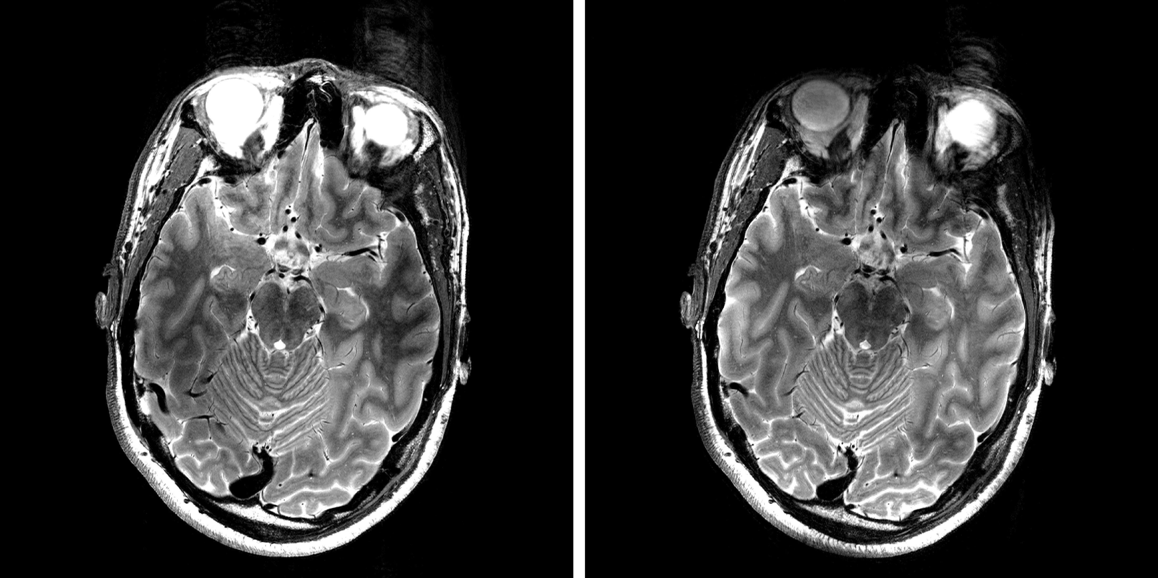
Direct Signal Control : TSE imaging at 7T
Original
DSC
High resolution FSE (0.3x0.3x1.2mm³). ETL=9
7T with 8-ch PTx
Sbrizzi et al, MRM 2017 77:361-373

Slide 19
Different time-frames of control
Static => consider the fields
Dynamic (single pulse) => consider the magnetization
Dynamic (multi-pulse) => consider the signal
Each has their own use cases!

Slide 20
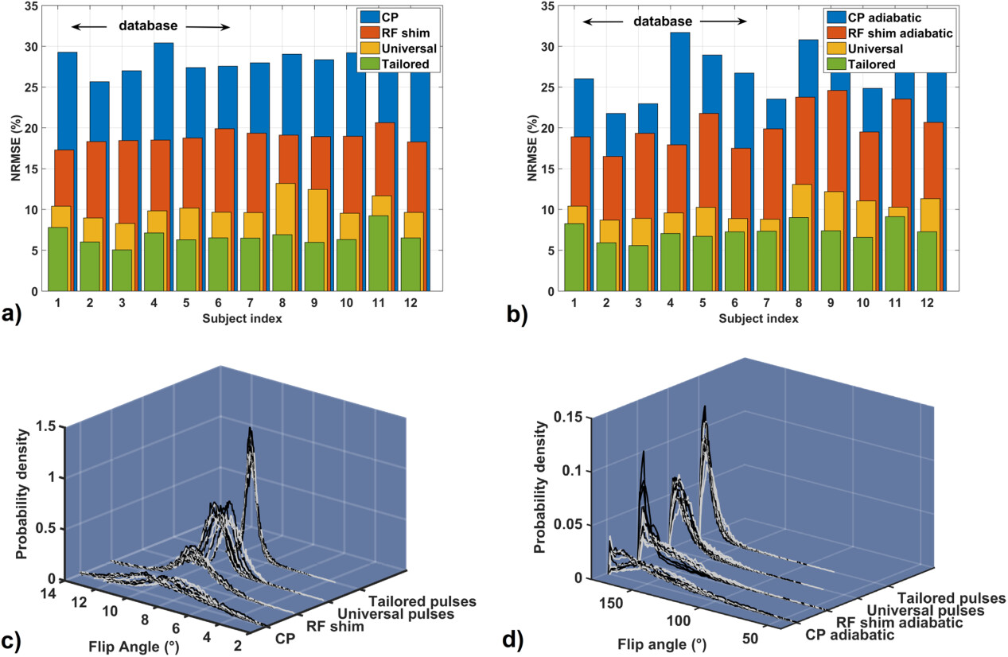
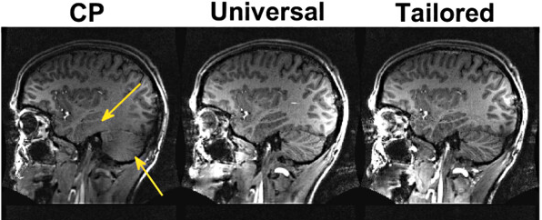
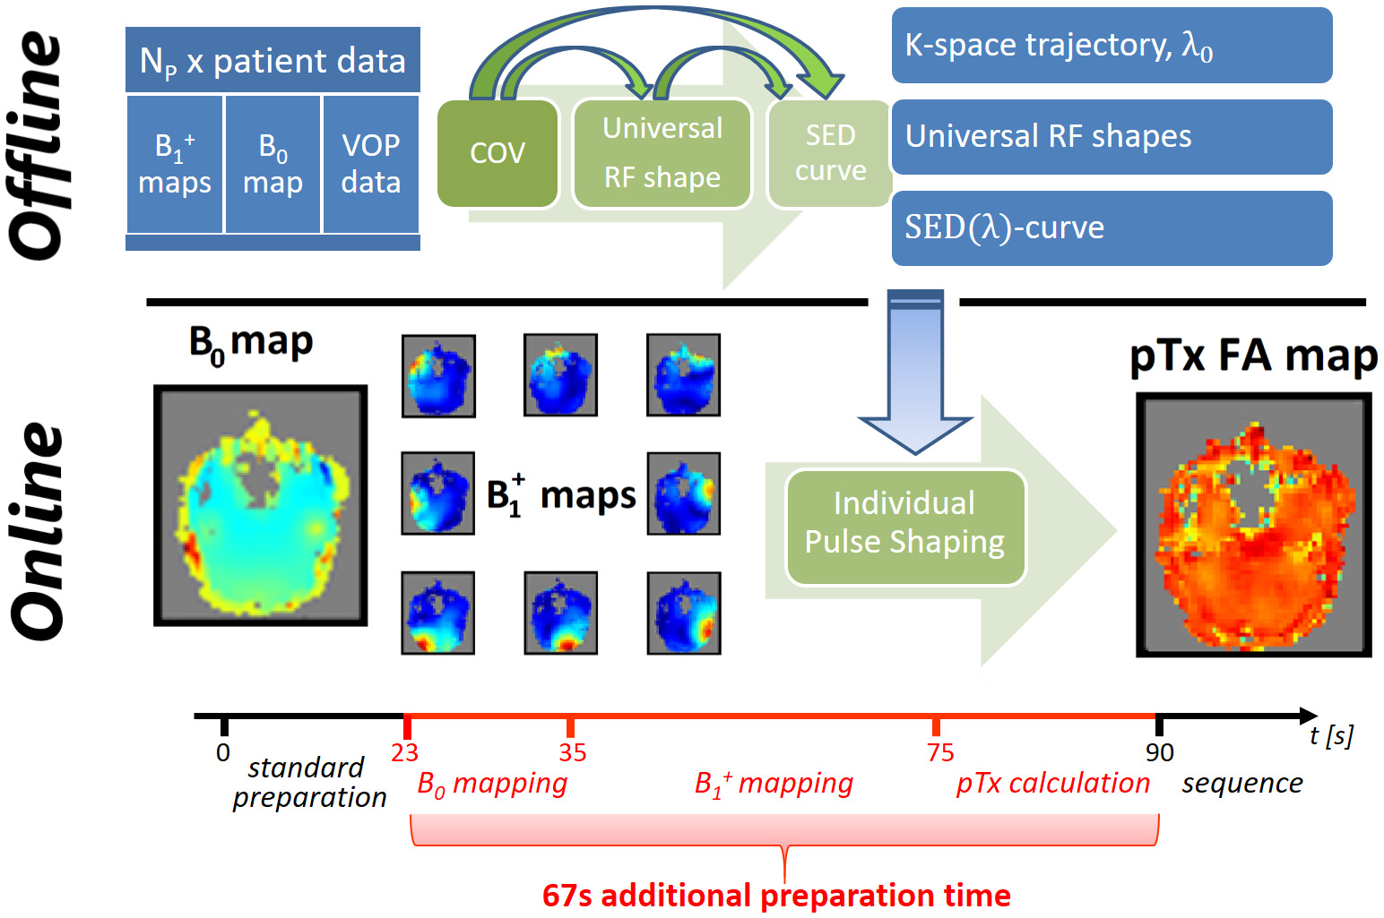
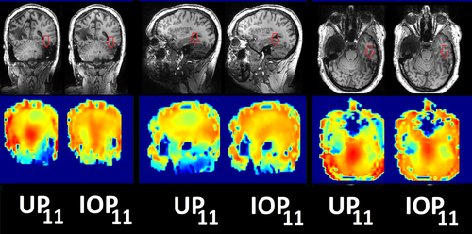
Do we always need to optimize?
’Universal’ pulse designs¹ – good performance achieved by ‘training’ on B1 data from multiple subjects
‘Hybrid’ universal / individual optimization (‘FOCUS’ pulse design²) provides refinement
¹Gras et al, MRM 2017 77 (2):635
²Herrler et al, MRM 2021 85:3140

Slide 21
Outlook
pTx gives spatial and temporal control of RF fields
Optimal method really depends on the application (not ‘one size fits all’)
Classic approaches are optimization based, but ‘learning’ is coming
‘universal’ solutions are a low-order type of learning
More bespoke methods are being researched

Slide 22
Thank you
Shaihan.malik@kcl.ac.uk https://www.kcl.ac.uk/people/shaihan-malik
© 2020 King’s College London. All rights reserved

